Slide 1
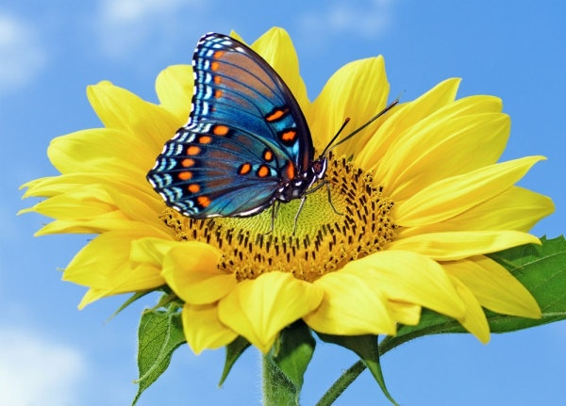
WELCOME

Slide 2
INTRODUCTION
Class: Seven
Sub: English 1st paper
Time:50 minutes.
Md.Nurmujahid Biswas
Assistant Teacher (Sociology)
Ratandia R.K.Model High School
Ratandia,Kalukhali,Rajbari.
Email:raisha8b@gmail.com
Mob:01714665780

Slide 3
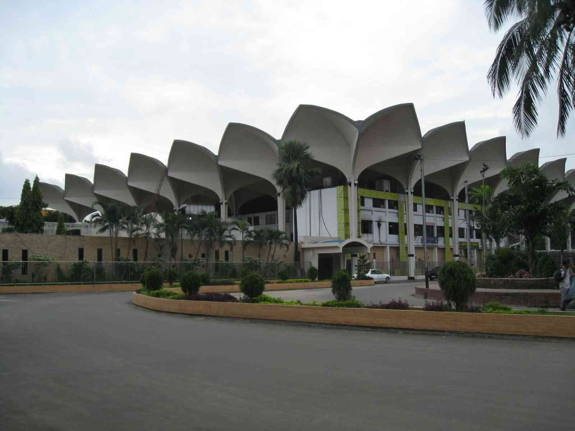
Look at the picture and thinking

Slide 4
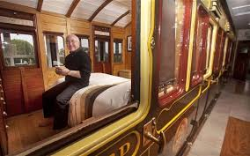
Look at the picture and thinking

Slide 5
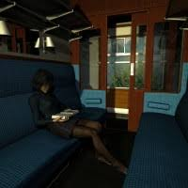
Look at the picture and thinking

Slide 6
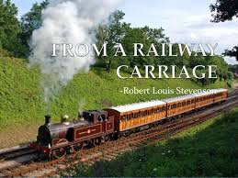
Can you guess what is our today’s topic?

Slide 7
Lesson Announchment
Unit: Six
Lesson: 06
From a Railway Carriage

Slide 8
Learning outcomes:
After we have studied this unit, we will be able to-
Key word;
Read and understand texts;
Ask and answer;
Read and enjoy poem;

Slide 9
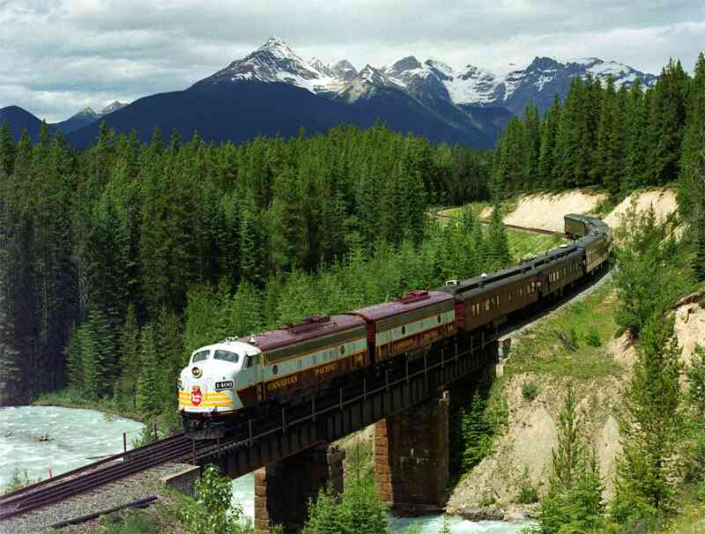
Read about From a Railway Carriage
from your text book.

Slide 10
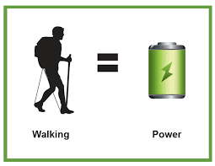
Keys words
Hedge (n) –
ছোট ছোট গাছ
Ditch (n) –
নালা/নদর্মা
Charge (v) –
প্রবল বেগে চলা
row of small trees or
bushes (like fences);
a long narrow channel dug
at the side of a field or road;
To move fast with force;

Slide 11
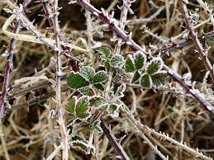
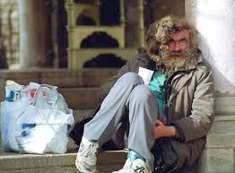
Keys words
wink (n) –
নিমিষ/পলক
bramble (n) –
কাঁটাযুক্ত বুনো ঘোপ
tramp (n) –
ভবঘুরে
an act of opening and closing an eye
quickly/a very short amount of time;
Wild bush with thorn;
A person who has no home ;

Slide 12
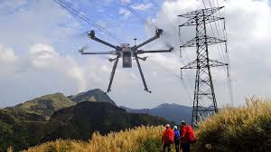
Keys words
stringing (v)–
ঝুলানো
lump (v) –
ভারাক্রান্ত হয়ে বিদঘুটেভাবে
এগিয়ে চলা
glimpse (n)-
এক ঝলক
Something that is hanging;
Proceed heavily or awkwardly ;
A look at something for a
While or a very short time;

Slide 13
Individually work
Questions-
Make a list of things that you can see passing quickly by a running train.

Slide 14
Ans to ques no-1
1.Meadow 2.cornfield 3.cattle 4.houses 5.trees 6.ponds 7.river 8.canals 9.lakes 10.hills

Slide 15
Pair work
Make list of the words and phrases that tell us about how fast train is running.

Slide 16
Ans: 1. faster than fairies
2.faster than witches
3.fly 4.in
the wink of an eye
5.glimpse

Slide 17
Evaluation
wink (n) –
নিমিষ/পলক
bramble (n) –
কাঁটাযুক্ত বুনো ঘোপ
tramp (n) –
ভবঘুরে
Hedge (n) –
ছোট ছোট গাছ
Ditch (n) –
নালা/নদর্মা
Charge (v) –
প্রবল বেগে চলা

Slide 18
THANK YOU

